Slide 1
Photo Essay- Dancing Through It All By Hannah Aitken

Slide 2
My photo essay shows the story of 4 dancers or different ages and how the issue of body image affects them in their daily lives as well as their dance careers.
For each dancer, in the first image I will explain who they are and their story, and throughout the images I will explain how their story progresses.
All of these stories are fiction, and I have changed the names of all the dancers photographed, but all the stories are based off of common body image issues in the ballet community.
All photos were taken at C.O.R.E Dance Project in Paris Ontario
Models (In Order Of Appearance): Kayla Cooper (16), Emily O’Neill (12) , Eden Andrade (10), Emma Franks (12), Maya Johnson (12) , Ivy Stevenson (12), Ella Aitken (12), Kallie Morrison (9), Hannah Martin (8) and Erica Calvesburt (9)

Slide 3
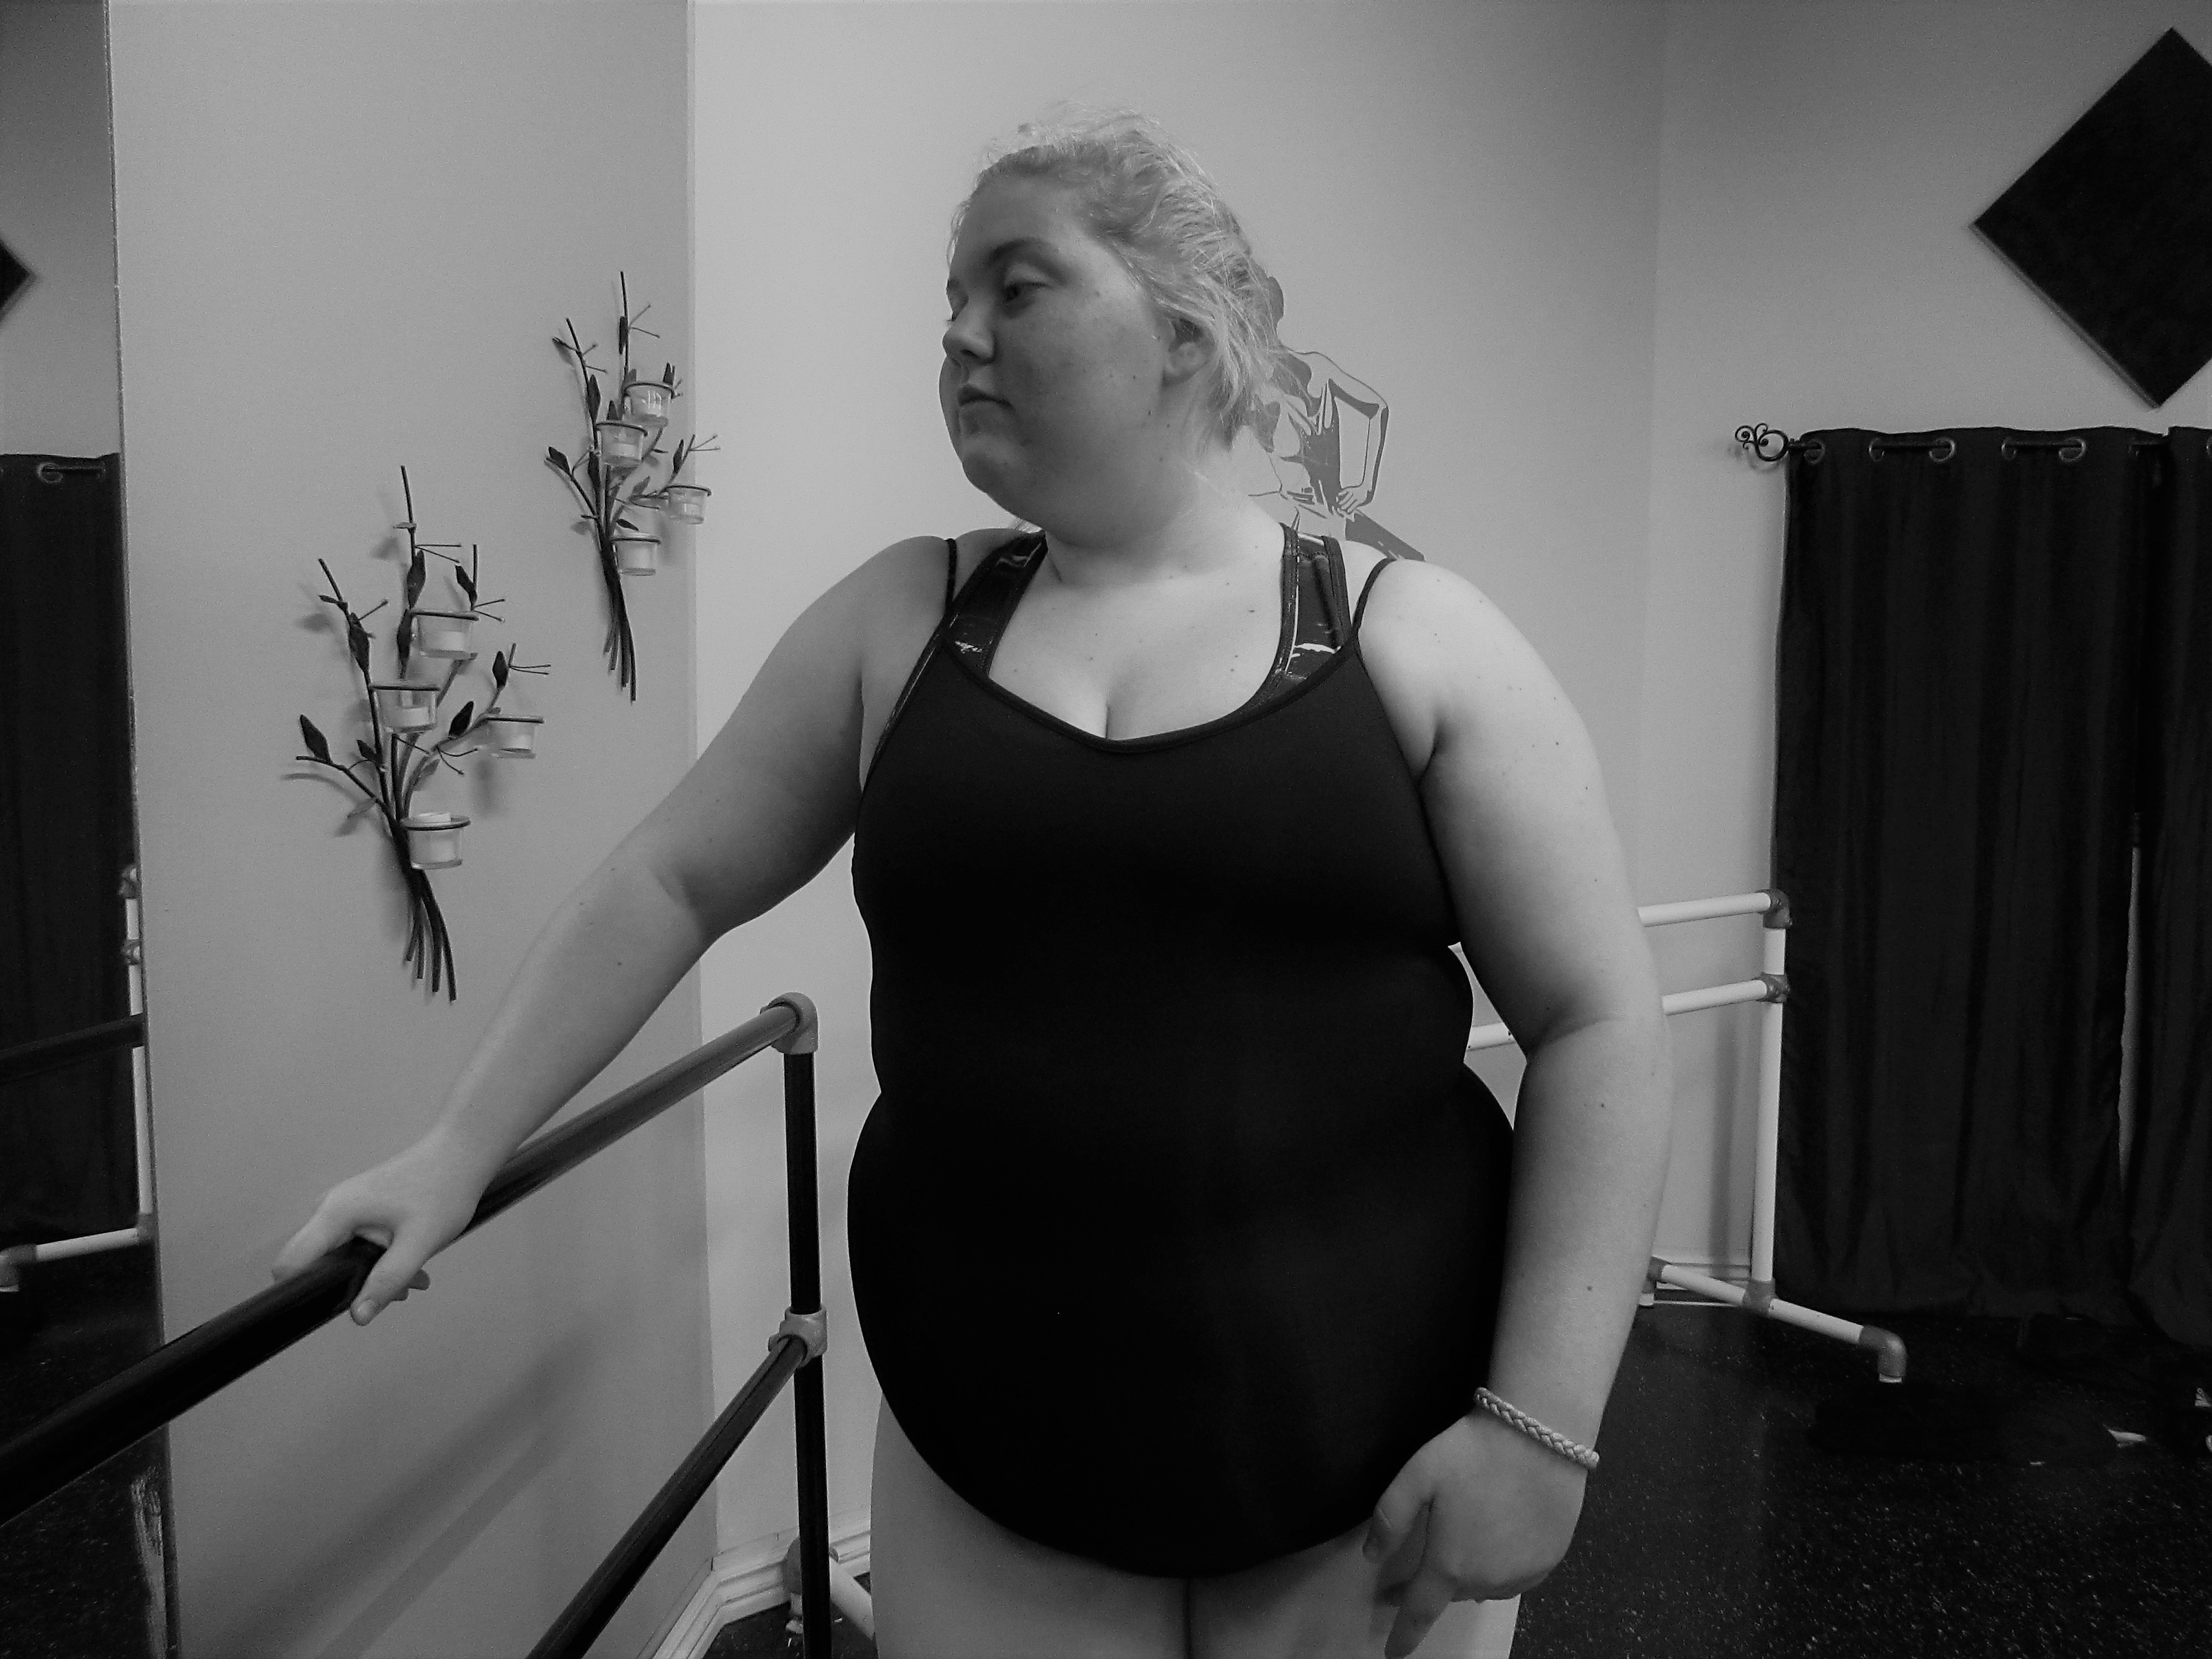

Slide 4
Sarah’s Story Photo One: Depression
The first story is Sarah’s. She knows she doesn’t have the typical dancers body and constantly being around girls that do has made her extremely self conscious and made her hate her body. She tried everything including diets and over exercising and nothing worked. Eventually, she developed depression and an severe eating disorder.
This picture shows how depressed she is and how looking in the mirror in class every day just reminds her of how much she hates her body and herself.

Slide 5
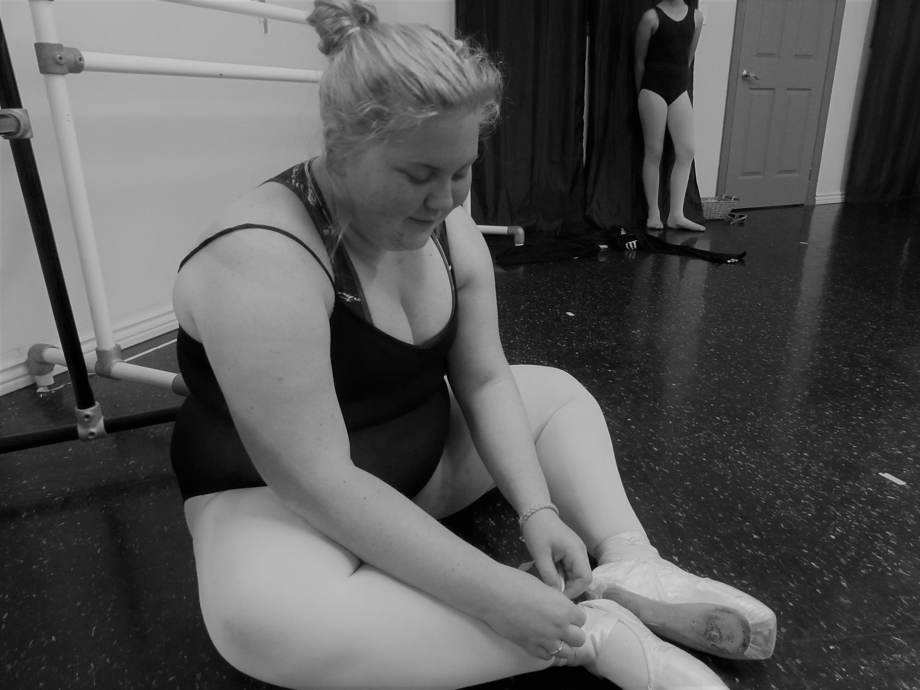

Slide 6
Photo 2: I Can Fake A Smile
The second and final photo of Sarah’s story shows that even though Sarah is extremely depressed, she tries to fake a smile everyday because she doesn’t want to show how self conscious she is and doesn’t want people to worry about her. This is dangerous because if she doesn’t show her emotions, no one will know she's struggling and no one will be able to help her.

Slide 7
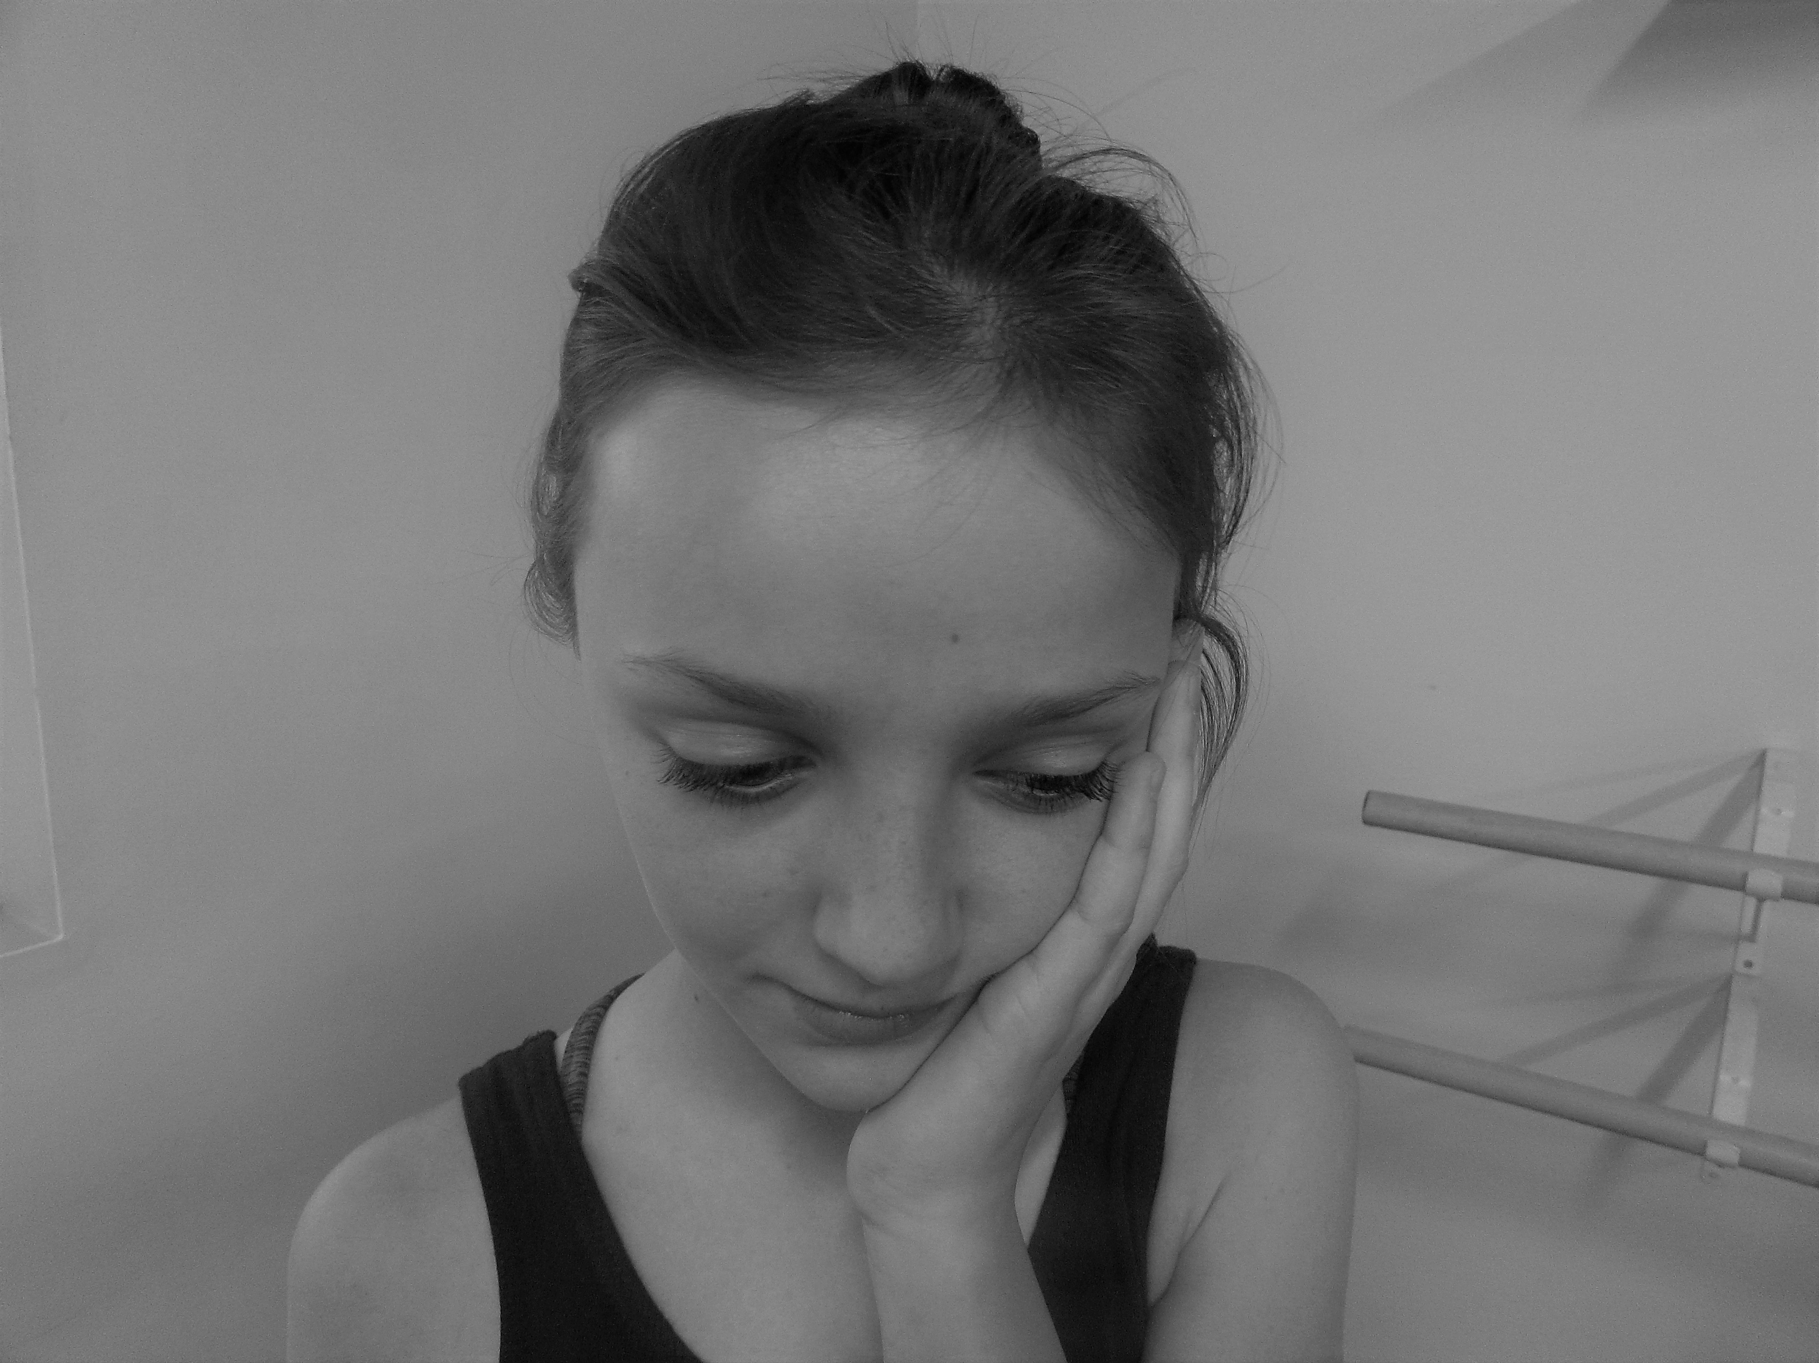

Slide 8
Julia’s Story Photo One: All In Her Head
The next story is Julia’s. Julia is a talented young dancer who has just turned 12. She used to be a confident, vibrant little girl but as she got older, things changed. Once she started getting more serious about dance and started going to professional auditions, she noticed all the other girls were so much thinner and better than her. Even though she has the perfect ballet body, she stopped seeing it that way. Now when she looks in the mirror, she's sees an altered version of herself. This is because she has developed Anorexia nervosa. She has lost all her self confidence, and now she is so paranoid that everything thinks she's overweight and constantly thinks people are whispering about her and making fun of her.

Slide 10
Photo Two: Everyone Is Staring At Me
In the second photo of Julia's Story, it shows that Julia believes that everyone is staring at her, but in reality, its all in her head.

Slide 12
Photo Three: Everyone Is Talking About Me
A progression of photo two, Julia now believes everyone is talking about her. Unlike photo two, this image doesn’t show the reality of what is going on, it shows what Julia sees in her head. This is because her anxiety is getting worse.

Slide 14
Photo Four: Everyone Is Laughing At Me
The forth and final photo of Julia's Story is a progression of the third photo. Now in Julia's head, not only are the other dancers talking about her, now they are laughing at her and making her feel isolated and alone. This demonstrates the worst stage of Julia's anxiety that her eating disorder caused.

Slide 16
Elizabeth’s Story Photo One: I Can’t Look In The Mirror
The third story in this series is Elizabeths. Elizabeth is 13 years old and wants to be a professional dancer. On her mock exam evaluation, her ballet teacher wrote “unacceptable ballet body”. Elizabeth had never even though about her body image before, but once she read this comment from her teacher, her entire mindset changed. All of a sudden, she became extremely self conscious about her body and believed that something was wrong with her. Now, she doesn’t even want to look at herself in the mirror.

Slide 18
Photo Two: I Can’t Do This Anymore
The second and final picture in Elizabeth's story shows her giving up on herself. The comment she received resulted in her hating ballet because it caused her so much emotional pain and every time she walked into the studio and saw her teacher, she was reminding of all the pain. After a few weeks, Elizabeth gave up on her dreams and quit ballet.

Slide 20
Emelia's Story Photo One: The Little Girls Can See
Our final story is Emelia’s. Emelia is 8 years old and idolizes all the older girls at her studio. Recently, she has noticed how sad all the older girls are getting and doesn’t understand why. She heard the older girls talking about their weight and about how they hate their bodies. Her and her friends don’t understand why. This picture is powerful because it shows how little kids notice everything the older girls are doing.

Slide 22
Photo Two: But The Big Girls Do It
The final photo of my essay I believe is the most powerful. It shows how children are so easily influenced. Emelia has noticed all the big girls she loves so much hating their bodies. Although she doesn’t fully understand why, she wants to be just like the older girls, so she starts doing it to. This could potentially lead to her developing a eating disorder or other serve body image issues.
This photo shows that children are so impressionable, and how young Emelia's story could turn into any of the older girls stories once she grows up because she is growing up in an environment full of her role models showing her that bad body image is something to aspire to.

Slide 23
CONCLUSION
This photo essay is meant to show all the aspects of body image and how it can happen to any dancer of any body type, age and level of capability.

